Slide 1
Information on Sexually
Violent Predator
Steve J. Garcia – DOB:
08/02/1953
P R E S E N T E D B Y T H E A D A M S C O U N T Y
S H E R I F F ’ S O F F I C E
S E X O F F E N D E R
R E G I S T R A T I O N U N I T

Slide 2
The legislature determined that Sexually Violent Predators (SVP) by definition pose a higher risk to the community at large and therefore mandated that upon their release from Department of Corrections (DOC), the community must be notified.
An SVP maybe be more likely to be arrested for a violent crime within five years upon release from DOC.

Slide 3
National Sex Offender Legislation
Jacob Wetterling Act 1994
Requires states to implement a sex offender and crimes
against children registry.
Megan’s Law 1996
Requires states to establish a community system.
notification

Slide 4
National Sex Offender Legislation
Pam Lychner Act 1996
Requires lifetime registration for recidivists and offenders who commit certain aggravated offenses.
Adam Walsh Act of 2006
Expanded The National Sex Offender Registry. strengthened federal penalties.
made It harder For sexual predators to reach our
children on the internet.
Background checks of adoptive and foster parents.

Slide 5
Occurs 2 ways in Colorado:
Passive and ongoing: through the sex offender
registration process
Active: via Community Notification
for those sex offenders determined by the courts to be Sexually Violent Predators (SVPs)

Slide 6
Most sex offenders engage in CROSSOVER behavior.
Many sex offenders have NO criminal history.
There is no “typical” sex offender, but all tend to be deceptive, manipulative, & secretive.
80-95% of sex offenses are committed by someone known to victim.
Sexual deviancy often begins in adolescence.
Sex offenses are not impulsive, they are usually carefully planned.
Most sex offenders are male , only 4% are female

Slide 7
Criminal Justice Supervision
Community Members

Slide 8
The community has vested interest in helping the offender be successfully managed in the community
Sex offenders have the same need for housing & employment as other citizens
Harassment is counter-productive to goals of community management & may cause the offender to go underground
ANY CITIZEN WHO USES THIS INFORMATION TO HARASS, THREATEN, OR INTIMIDATE THE OFFENDER WILL BE SUBJECT TO CRIMINAL PROSECUTION

Slide 9
There are nearly 400,000 sex offenders across the United
States
As of 3-03-2021 there are approximately 19,939 registered sex offenders in Colorado.
As of 3-03-2021 there are approximately 334 SVP’s on the website.
As of 3-03-2021, there are approximately 498 registered sex offenders in unincorporated Adams County Colorado
Approximately 65% of convicted sex offenders are placed on
probation in CO., (rest to DOC & community corrections.)
Offenders may be caught for one type of offense, & be at high risk to commit another type.
Crime of conviction is only one indicator of risk.

Slide 10
Majority of sex offenders are not caught or detected.
Less than 16% of sex assaults are EVER reported.
In Co., 1 in 150 women & 1 in 830 men have been sex assault victims in the past 12 months, 16% were reported to police, 1 in 4 women & 1 in 17 men have been sex assault victims in their lifetimes.
(CDPHE, CCASA 1999)

Slide 11
Victims exhibit many different responses: crying, angry, quiet, withdrawn. No “normal” response.
Sex assault by someone known to victim creates a more
difficult recovery.
Victims often develop post-traumatic stress disorder.
Long-term effects include; depression, anxiety, eating disorders, flashbacks, divorce, loss of sexual interest, loss of concentration, sleeping disorders, and suicide.
Male victims tend to develop anti-social behaviors; females tend to develop depression; both can develop substance abuse problems.
Responses are minimized when victims are believed & supported.

Slide 12
Full list is available by contacting the Adams County
Sheriff’s Office at 720-322-1202.
Felons and those with multiple convictions are posted on the Internet at http://www.sotar-us/sotar-public/initpublicoffendersearchredirect.do

Slide 13
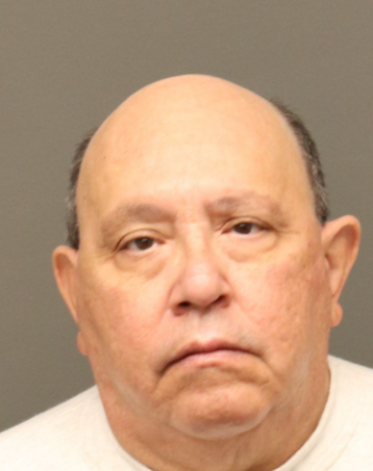
SEXUALLY VIOLENT PREDATOR
Steve J. Garcia
DOB: 08/02/1953
W/M, 5’7”, 250 lbs.
Grey/Black Hair, Brown Eyes

Slide 14
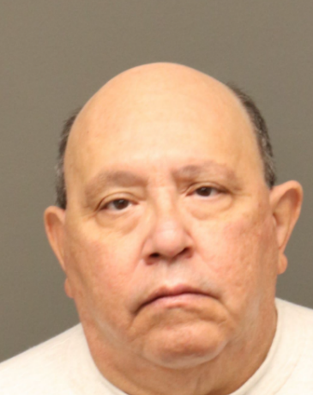
Brief History and Change of Status
Convictions:
Attempt Criminal Sexual Assault on a Child
Sexual Assault/Child/Pos Trust/Victim Under 15

Slide 15
Criteria of SVP
1: Age 18 or older on the date of the offense or under 18 and tried as an adult
Steve J. Garcia
Attempt Criminal Sexual Assault on a Child
Sexual Assault/Child/Pos Trust/Victim Under 15

Slide 16
Criteria for SVP
2. The crime must have been committed on or after July 1, l997 and convicted on or after July 1, 1999.
Sexual Assault
Unlawful Sexual Contact (felony)
Sexual Assault on a child
Sexual Assault on a child/Position of Trust
Includes:
Attempt, conspiracy, or solicitation
Steve J. Garcia
1990
Attempt Criminal Sexual Assault on a Child
2004
Sexual Assault/Child/Pos Trust/Victim Under 15

Slide 17
Criteria for SVP
3. The relationship to the victim must have been:
A stranger to the offender.
The offender actively manipulated the
environment to gain access to the victim.
The offender introduced sexual into the relationship.
The offender persisted in the
introduction of sexual content or
inappropriate behavior of a sexual nature despite lack of consent or in the absence of consent.

Slide 18
Criteria for SVP
4: Positive results, or the “passing of a risk assessment instrument”, which includes
Steve J. Garcia
was evaluated by Parole and found to have “positive results”
 an assessment for the presence
of: mental abnormality;
 level of denial regarding the offense;
 treatment appropriateness and
motivation;
 presence of sexual deviant interests.
 Administered by:
Probation/parole staff AND a qualified treatment evaluator, approved by the SOMB

Slide 19
Steve J. Garcia
Current Legal Status:
On Parole
Registered Sexual Offender
Must be registered as a sex offender
Must reside at the residence registered with local law enforcement

Slide 20
Must register with the Adams County Sheriff’s Office Sex Offender Registration Unit
Steve J. Garcia
Current Legal Status:
On Parole
Quarterly
Lifetime
Residence is verified quarterly by the Sex Offender Registration Unit

Slide 21
SVP’s Do Not Represent All Dangerous Sex Offenders,
The Community Notification Process and Sex Offender Registration are Not a Complete Deterrent to Sexual Assault.
Please Refer to your Safety Tips

Slide 22
Vigilantism, harassment, threats or intimidation of the offender is counter- productive to the best interests and safety of the community. We want the offender to be:
 Registered and visible in the community
 Not underground
Such activity is criminal and will be investigated and the actor will be subject to prosecution

Slide 23
Colorado Bureau of Investigation (CBI)
http://sor.state.co.us/
Dru Sjodin National Sex Offender Public Website:
http://www.nsopw.gov/Core/Conditions.aspx
National Sexual Assault Hotline at: 800-656-HOPE
National Center for Missing and Exploited Children http://www.missingkids.com
The Center for Sex Offender Management website:
http://www.csom.org

Slide 24
Community Notification
Informed Communities Are
Safer Communities
(SOMB 12/06)

